Slide 1
Welcome to
User Experience Fundamentals
Start time – 9:30
Andy Smith BSc MCITP NPQSL
Principal Technical Learning Specialist

Slide 2
troubleshooting
If I disconnect
One of you will automatically become host
Please don’t leave the session
If you disconnect
Don’t panic!
Re-join using your link
Contact
Chat: link from your joining email
Email: virtual.learningteam@qa.com
Phone: 0203 908 2376
When I return, I’ll resume the course

Slide 3

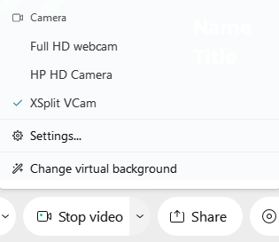
WE’D LOVE TO
SEE YOU!
Please start your video
Click on Start video at bottom of the meeting window
Notes:
Encourage learners to turn on their videos

Slide 4
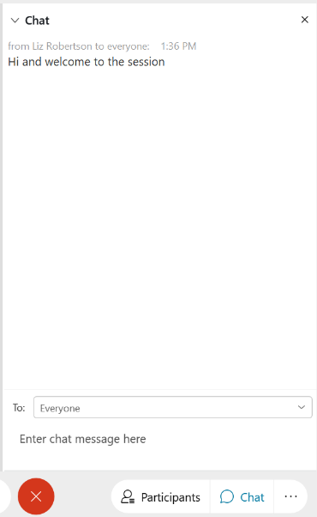
CHAT WINDOW
Ask & Answer Questions
Add comments
Notes:
Ask learners to send to Everyone, rather than just Host
Everyone then sees questions, answers and comments from everyone and feels more connected

Slide 5
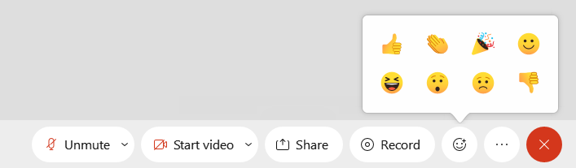
REACTIONS
Interesting Topic?
Got a Question?
Notes:
Encourage learners to use Raised Hands and Reactions regularly to confirm understanding of a topic / ask a question / check in with you

Slide 6
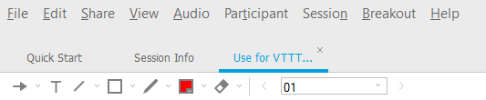
ANNOTATION TOOLS

Slide 7
Manuals
Times
Refreshments
Toilets
Questions
House
keeping
7

Slide 8


BREAK TIMES
 | Approx. Timings
 | 9:30 | ̶ | 11:00
 | 11:00 | ̶ | 11:15
 | 11:15 | ̶ | 12:30
 | 12:30 | ̶ | 13:30 | Lunch
 | 13:30 | ̶ | 15:00
 | 15:00 | ̶ | 15:15
 | 15:15 | ̶ | 16:30 | Finish

Slide 9
Introducing User Experience
The Strategy Plane
The Scope Plane
The Structure Plane
The Skelton Plane
The Surface Plane
Course
outline

Slide 10

Be prepared to get involved
Notes:
CHRIS go to MIRO

Slide 11

A Bit About You
  Existing knowledge
  Job Role
  Objectives for the course
Your experience

Slide 12
Let’s get started

Slide 13
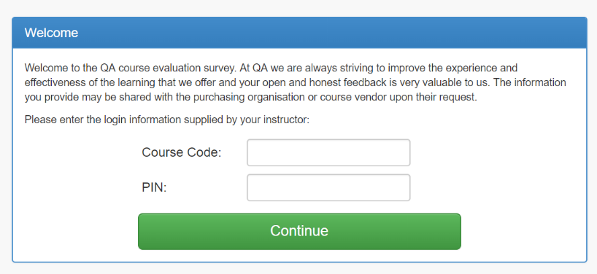
Training Evaluation
www.qa.com/eval
QAUX
4581275-04

